Slide 1

Cluster Validation Statistics

Slide 2
Cluster Validation Statistics
The term cluster validation is used to design the procedure of evaluating the goodness of clustering algorithm results. This is important to avoid finding patterns in a random data, as well as, in the situation where you want to compare two clustering algorithms.
Generally, clustering validation statistics can be categorized into 3 classes

Slide 3
Cluster Validation Statistics
1. Internal cluster validation, which uses the internal information of the clustering process to evaluate the goodness of a clustering structure without reference to external information. It can be also used for estimating the number of clusters and the appropriate clustering algorithm without any external data.

Slide 4
Cluster Validation Statistics
2. External cluster validation, which consists in comparing the results of a cluster analysis to an externally known result, such as externally provided class labels. It measures the extent to which cluster labels match externally supplied class labels. Since we know the “true” cluster number in advance, this approach is mainly used for selecting the right clustering algorithm for a specific data set.

Slide 5
Cluster Validation Statistics
3. Relative cluster validation, which evaluates the clustering structure by varying different parameter values for the same algorithm (e.g.,: varying the number of clusters k). It’s generally used for determining the optimal number of clusters.

Slide 6
Internal measures for cluster validation
We describe the most widely used clustering validation indices. Recall that the goal of partitioning clustering algorithms is to split the data set into clusters of objects, such that:
• the objects in the same cluster are similar as much as possible,
• and the objects in different clusters are highly distinct

Slide 7
Internal measures for cluster validation
That is, we want the average distance within cluster to be as small as possible; and the average distance between clusters to be as large as possible.
Internal validation measures reflect often the compactness, the connectedness and the separation of the cluster partitions.

Slide 8
Internal measures for cluster validation
1. Compactness or cluster cohesion: Measures how close are the objects within the same cluster. A lower within-cluster variation is an indicator of a good compactness (i.e., a good clustering). The different indices for evaluating the compactness of clusters are base on distance measures such as the cluster-wise within average/median distances between observations.

Slide 9
Internal measures for cluster validation
2. Separation: Measures how well-separated a cluster is from other clusters. The indices used as separation measures include:
- distances between cluster centers
- the pairwise minimum distances between objects in different clusters

Slide 10
Internal measures for cluster validation
3. Connectivity: corresponds to what extent items are placed in the same cluster as their nearest neighbors in the data space. The connectivity has a value between 0 and infinity and should be minimized.

Slide 11
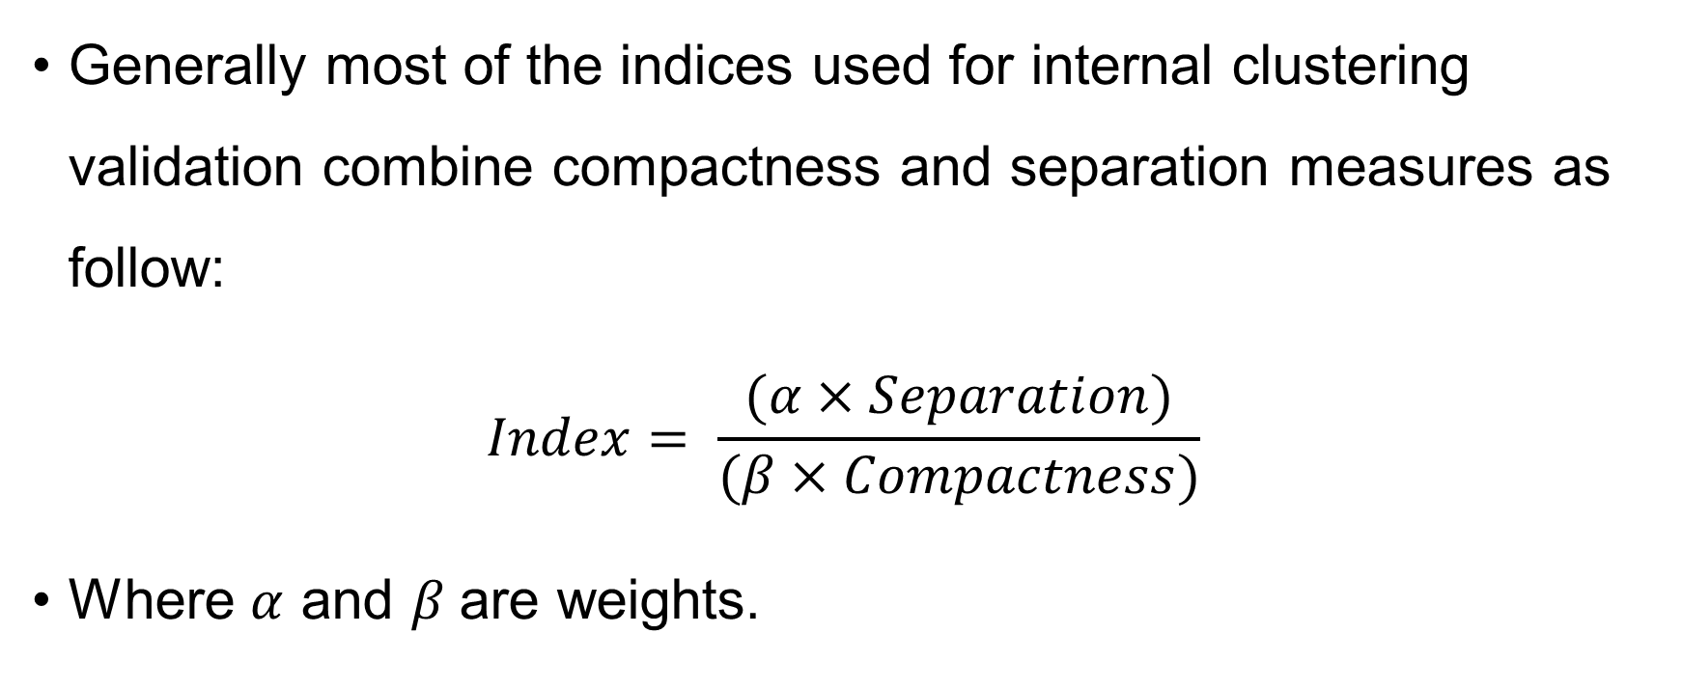
Internal measures for cluster validation
Generally most of the indices used for internal clustering validation combine compactness and separation measures as follow:
$$Index= \frac{(α×Separation)}{(β×Compactness)}$$
Where $α$ and $β$are weights.

Slide 12
Dunn index
The Dunn index is an internal clustering validation measure which can be computed as follow:
1. For each cluster, compute the distance between each of the objects in the cluster and the objects in the other clusters
2. Use the minimum of this pairwise distance as the inter-cluster separation (min.separation)

Slide 13
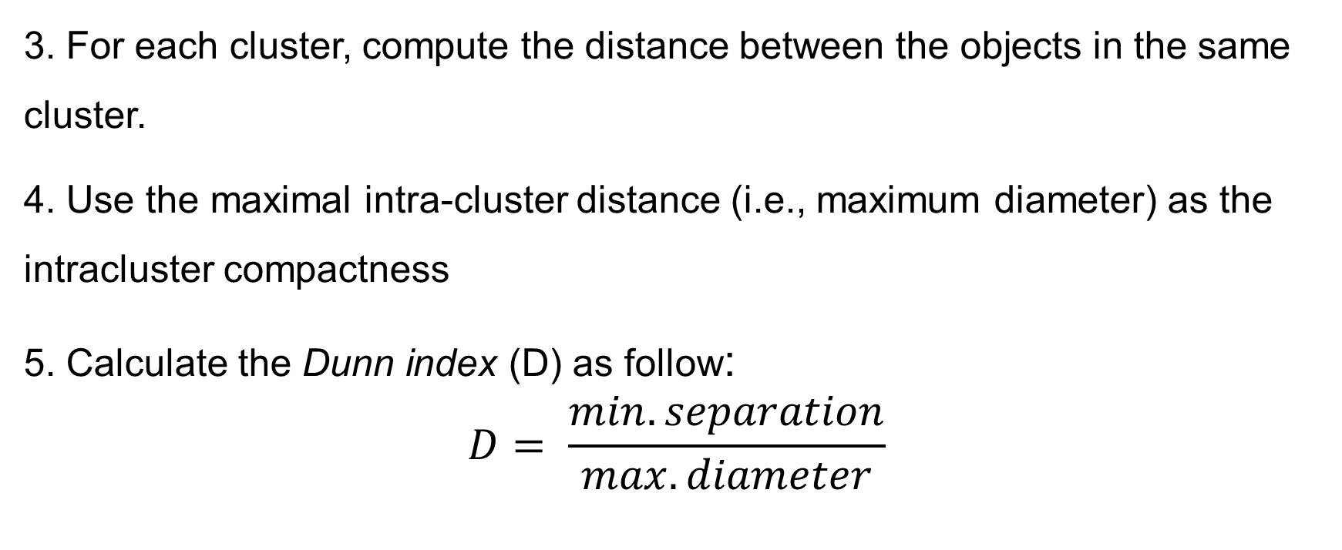
Dunn index
3. For each cluster, compute the distance between the objects in the same cluster.
4. Use the maximal intra-cluster distance (i.e., maximum diameter) as the intracluster compactness
5. Calculate the Dunn index (D) as follow:
$$D= \frac{min.separation}{max.diameter}$$

Slide 14
Dunn index
If the data set contains compact and well-separated clusters, the diameter of the clusters is expected to be small and the distance between the clusters is expected to be large. Thus, Dunn index should be maximized.
Note: The Silhouette coefficient is another index used for internal clustering validation

Slide 15
External measures for clustering validation
The aim is to compare the identified clusters (by k-means, pam or hierarchical clustering) to an external reference.
It’s possible to quantify the agreement between partitioning clusters and external reference using either the corrected Rand index and Meila’s variation index VI, which are implemented in the R function cluster.stats()[fpc package].

Slide 16
External measures for clustering validation
The corrected Rand index varies from -1 (no agreement) to 1 (perfect agreement).
External clustering validation, can be used to select suitable clustering algorithm for a given data set.

